Slide 1
Test plan discussion
Fan Heater

Slide 2
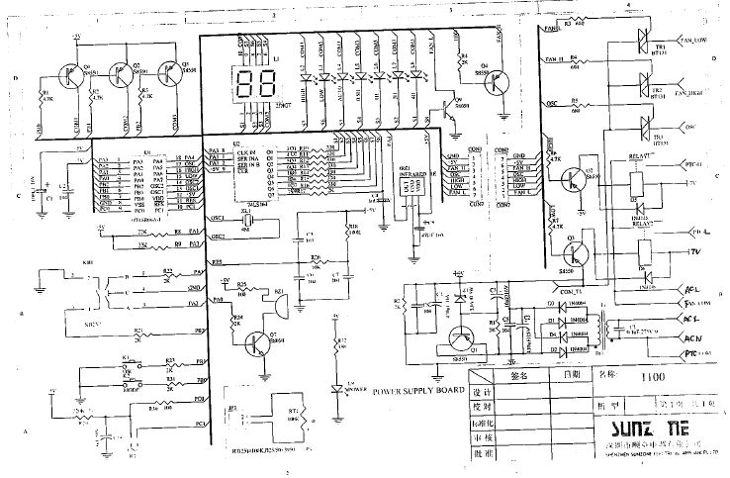
Circuit Diagram

Slide 3
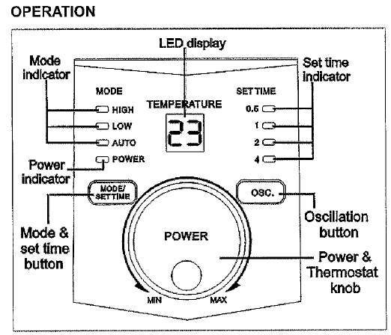
Additional information- program chart

Slide 4
Disturbance Source
IC
Relay
Crystal oscillator
LCD

Slide 5
Sensitive components for immunity test
IC
TRIAC

Slide 6
Applicable standards
Household appliance
EN 55014-1
EN 55014-2
EN 61000-3-2
EN 61000-3-3

Slide 7
Test items/operation modes
Disturbance voltage
  AC Mains, Adjust to find the maximum disturbance
Disturbance Power
  AC Mains, Adjust to find the maximum disturbance
Click test
  Keep warm

Slide 8
Test items/operation modes
Flicker
  10 mins
Harmonics
  Class A
ESD
  Cooking, standby
EFT
  Cooking, standby
CS
  Cooking
Surge
  Cooking
Dips
  Cooking

